Slide 1
ITEC 101 FUNDAMENTALS OF IT
DANIEL OBUOBI, DCSIT,CU
COMPUTER HARDWARE, Evaluation of Hardware Components

Slide 2
Components
Computers are organized according to the following system functions:
Input: keyboards, touch screens, pens, electronic mice, optical scanners
Processing: CPU(ALU, Control Unit)
Output: video display units, printers, audio units
Storage: primary memory, secondary memory, primary storage, secondary storage
Control: registers and other circuits of the control unit

Slide 3
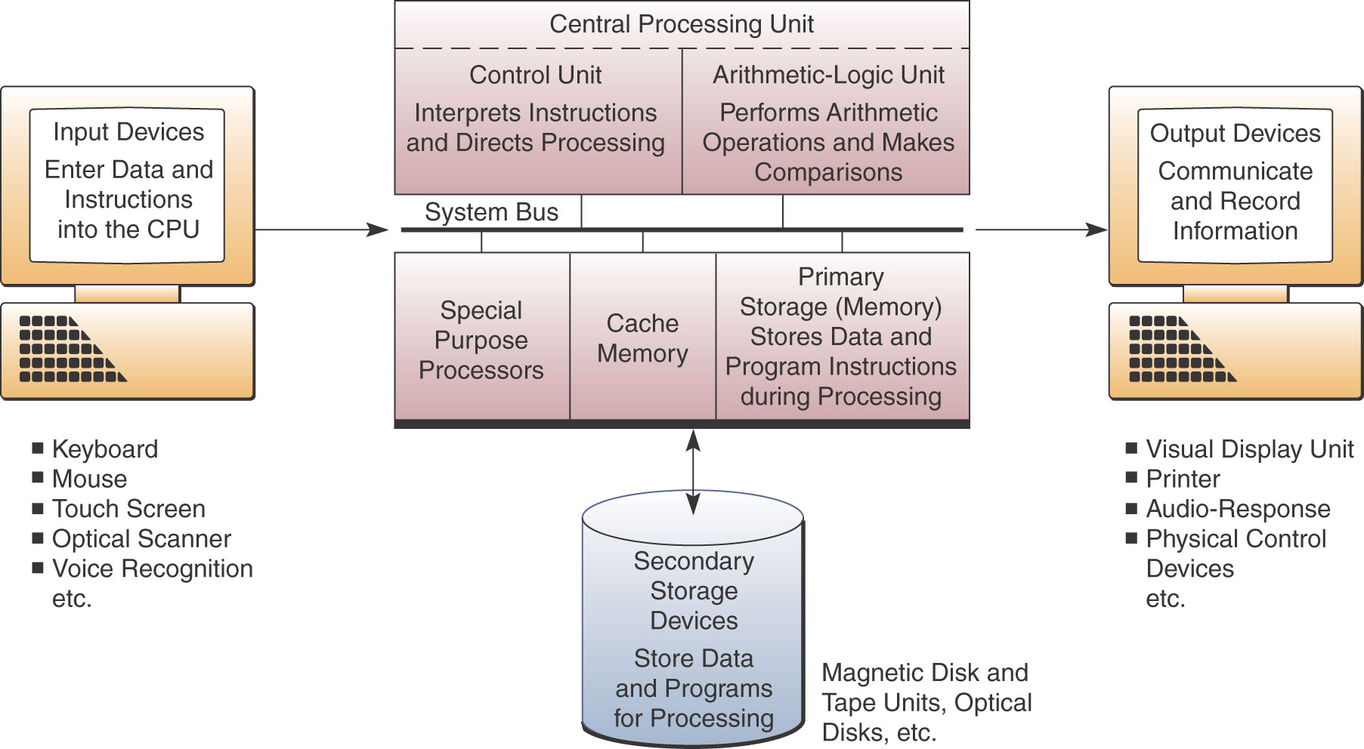
Internal Structure

Slide 4
CPU
Central Processing Unit: the brain, processor, center, chip
Two components
Control unit:
Literally, in control.
Directs the entire computer system to carry out stored program instructions.
Communicates and instruct with both the arithmetic logic unit (ALU) and main memory.
Arithmetic Logic Unit
Arithmetic operations: addition, subtraction, multiplication and division.
Logical operations compare numbers, letters and special characters, AND, OR and NOT.
Comparison operations test for three conditions, =, <, >

Slide 5
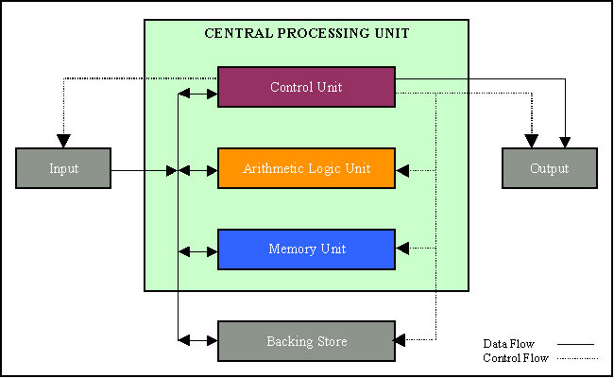
CPU

Slide 6
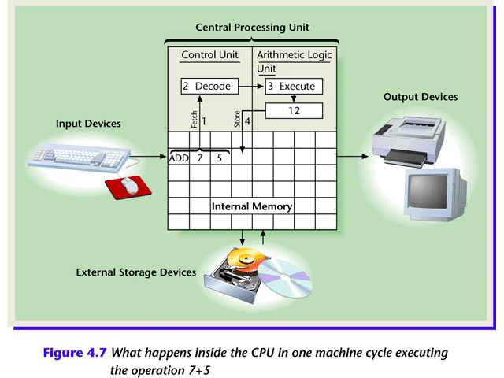
CPU

Slide 7
CPU
Machine Cycle: CPU’s execution of four functions, Fetch, Decode , Execute , Store
Clock rate or frequency
the rate of repetitive cycles. One cycle per second is 1 herz. Mhz,
System clock
a special circuit used by CPU to synchronizes all tasks.
Data word
the maximum number of bits fetched by CPU from internal memory in one machine cycle, e.g., 8, 16,32,64 128. The larger, the better.

Slide 8
Computer Memory
Registers
On CPU chip
Temporary storage, quick retrieval.
The larger, the better.
Internal Memory
Random access memory (RAM)
Read-only memory (ROM)
External Memory
Magnetic disks, magnetic tapes, optical discs

Slide 9
RAM & ROM
Random Access Memory
The main store: the place where the programs and software
READ/WRITTEN
CPU fetches the program instructions
CPU store the results of calculations
The more RAM, the larger the programs you can run.
When a computer off, lose whatever is stored
Read Only Memory (or ROM).
Fetch or read instructions only
Instructions permanently stored inside, cannot be over-written
Used for storing special sets of instructions e.g., BIOS
When the computer off, the contents remain
Non-volatile: Permanent

Slide 10
Cache Memory
a part of RAM
CPU also has Cache
Made up of fast memory chips, i.e. SRAM
For CPU to access
Stores the most frequently used instructions of the programs
Allow faster retrieval and execution

Slide 11
The Power of Computer
Clock rate (measured in cycles per second)
Amount of information the CPU can process per second
Speed determined only by combination of both factors
Network
Interface
Card
CPU
RAM
ALU
8/16/32/64/128/256-bit
Computer Internal Bus

Slide 12
Register
Cache
RAM
cost
ROM
Speed
M disk
Opti disk
M tape
Size

Slide 13
Input, output and storage

Slide 14
Input Technologies
Enter data and commands directly into a computer
Keyboard
Electronic mouse
Trackball
Pointing stick
Touch pad
Touch screen

Slide 15
Source Data Input Devices
Copy data directly from the source
Optical mark recognition: detect the positions of marks
Optical bar recognition: data encoded in the serious of thick and thin black bars in bar codes.
Optical character recognition: hardware(scanner), software(OCR)
Magnetic-ink Character Recognition: banking checks
Credit card reader:
Speech recognition

Slide 16
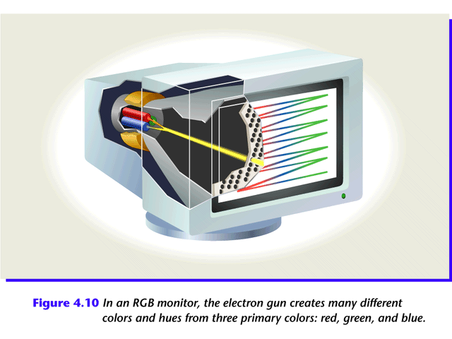
Output Technologies
In an RGB monitor, the electron gun creates many different colors and hues from three primary colors: red, green, and blue.

Slide 17
Monitor
Resolution: number of pixels that fit the width and height of a complete screen image. The higher, the better.
Refresh rate: the frequency at which the gun sweeps the screen. The higher the better. 72Hz
Depends on resolution. The rate decreases as resolution increases.
The higher the rate, the less flickering on the screen and strain on eyes.
Dot pitch: the distance between the centers of any two triads, or what we think of as dot center to dot center.
Cathode-Ray Tube(CRT)
A layer of pixels on the inner side of the screen
Electron gun: sending our electrons
Electrons hit the pixels (three different layers, colors), which emit light, display different colors

Slide 18
Monitor
Monochrome monitors
Often seen in POS.
Flat-panel monitors:
Liquid crystal display(LCD)
Liquid crystal on the screen
Voltage to screen disrupts the crystal’s regular structure, causing it to block light.
View Angle
Read that from Bestbuy.com

Slide 19
Printers
Non-impact
Laser, ink-jet, electrostatic, electrothermal
PPM: pages per minute
DPI: dots per inch
Impact:

Slide 20
Storage
Information is stored through the presence or absence of light, electronic or magnetic signals
Binary representation: 1 = ON, 0 = OFF
CD-ROM, CD-R,CD-RW
DVD: 4 times capacity of CDs
How are 1 and 0 expressed in a CD?
How are 1 and 0 expressed in a MD?

Slide 21
Storage
Direct access: or random access
An element of data or instructions can be directly stored and retrieved by selecting and using any of the locations on the storage media
Each storage position
Has a unique address
Can be individually accessed in approximately the same time
Sequential access
Does not have unique storage addresses
Serial process
Data are recorded one after another in a predetermined sequence.
Locating an individual item requires searching all of the data until the desired item is located

Slide 22
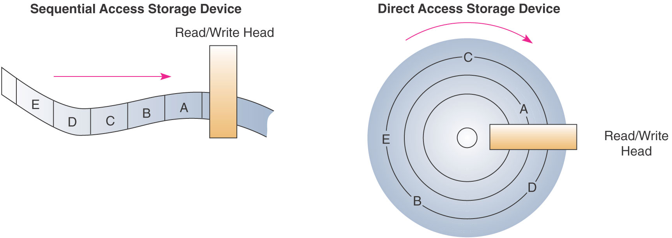
Storage

Slide 23
Enterprise Storage Systems
RAIDs: Redundant Arrays of Independent Disks
Provides large capacities with high access speeds
Data are accessed in parallel over multiple paths from many disks
Fault tolerant
SANs: Storage Area Networks: Fiber channel LANs that connect many RAID units
Storage Service Providers (SSPs)

Slide 24
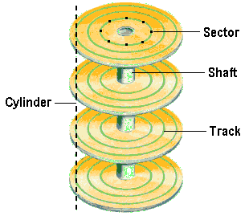
Hard Disk

Slide 25
Hard Disk
Boot Record:
the information in the first sector of any hard disk or diskette that identifies how and where an operating system is located so that it can be boot (loaded) into the computer's main storage or RAM.
File Allocation Table
a table that an operating system maintains on a hard disk that provides a map of the clusters (the basic units of logical storage on a hard disk) that a file has been stored in.
Sector
one of the "pies slices" the diskette or disk is divided into, the unit of recording data

Slide 26
EVALUATING THE SYSTEM

Slide 27
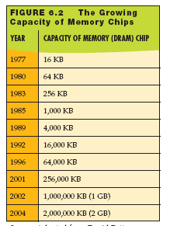
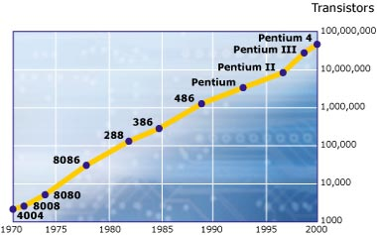
To Buy or To Upgrade?
Things to consider:
Moore’s Law
Cost of upgrading vs. buying
Time installing software and files
Needs and wants
Notes:
A rule of thumb often cited in the computer industry, called Moore’s Law, describes the pace at which CPUs improve. This mathematical rule, named after Gordon Moore, the cofounder of the CPU chip manufacturer Intel, predicts that the number of transistors inside a CPU will increase so fast that CPU capacity will double every 18 months. (The number of transistors on a CPU chip helps determine how fast it can process data.)
This rule of thumb has held true since 1965, when Moore first published his theory.
In addition to the CPU becoming faster, other system components also improve dramatically. For example, the capacity of memory chips such as DRAM—the most common form of memory found on PCs—increases about 60 percent every year.
When deciding whether to upgrade or buy new, consider the costs involved, the time it would take to transfer all of your files and to reinstall and reconfigure your software, as well as your needs and wants.

Slide 28

Assessing Your Hardware: Evaluating Your System
Assess the computer’s subsystems
The subsystems include:
CPU
RAM
Virtual memory
Storage devices
Video
Audio
Ports
Notes:
To determine whether your computer system has the right hardware components to do what you want it to do, you need to conduct a system evaluation. To do so, you look at your computer’s subsystems, what they do, and how they perform:
CPU
RAM
The storage subsystem (your hard drive and other drives)
The video subsystem (your video card and monitor)
The audio subsystem (your sound card and speakers)
Your computer’s ports
.

Slide 29
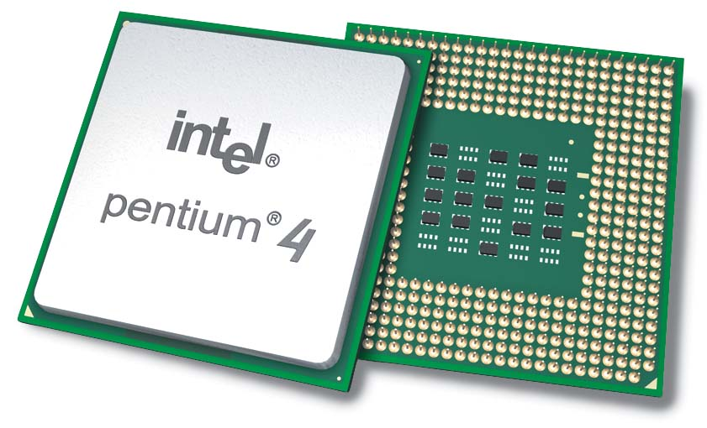
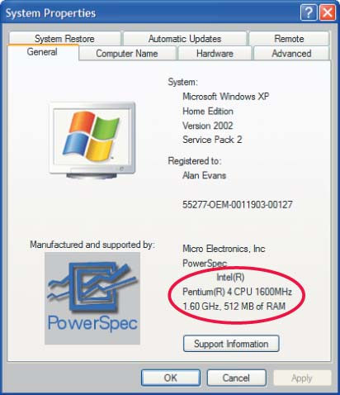
Evaluating the CPU
How does the CPU work?
Control unit
Arithmetic logic unit (ALU)
Machine cycle:
Instruction Cycle
Fetch
Decode
Execution Cycle
Execute
Store
Speed:
Mhz
Ghz
Notes:
The CPU or processor is the “brains” of the computer. It processes instructions, performs calculations, manages the flow of information through a computer system, and is responsible for processing the data you input into information.
The CPU is located on the motherboard.
The CPU is composed of two units: the control unit and the arithmetic logic unit (ALU).
The control unit coordinates the activities of all the other computer components.
The ALU is responsible for performing all the arithmetic calculations and makes logic and comparison decisions, such as comparing items to determine if one is greater than, less than, equal to, or not equal to another.
Every time the CPU performs a program instruction, it goes through the same series of steps, called a machine cycle:
First, it fetches the required piece of data or instruction from RAM.
Next, it decodes the instruction into something the computer can understand.
Once the CPU has decoded the instruction, it executes the instruction.
It then stores the result to RAM before fetching the next instruction.
The computer goes through these machine cycles at a steady and constant pace. This pace, known as clock speed, is controlled by the system clock, which works like a metronome in music.
The system clock keeps a steady beat, regulating the speed at which the processor goes through machine cycles
. Processors work incredibly fast, going through millions or billions of machine cycles each second. Processor speed is measured in units of MHz and GHz. Hertz here means “machine cycles per second,” so a 3.0-GHz processor performs work at a rate of 3 billion machine cycles per second.

Slide 30
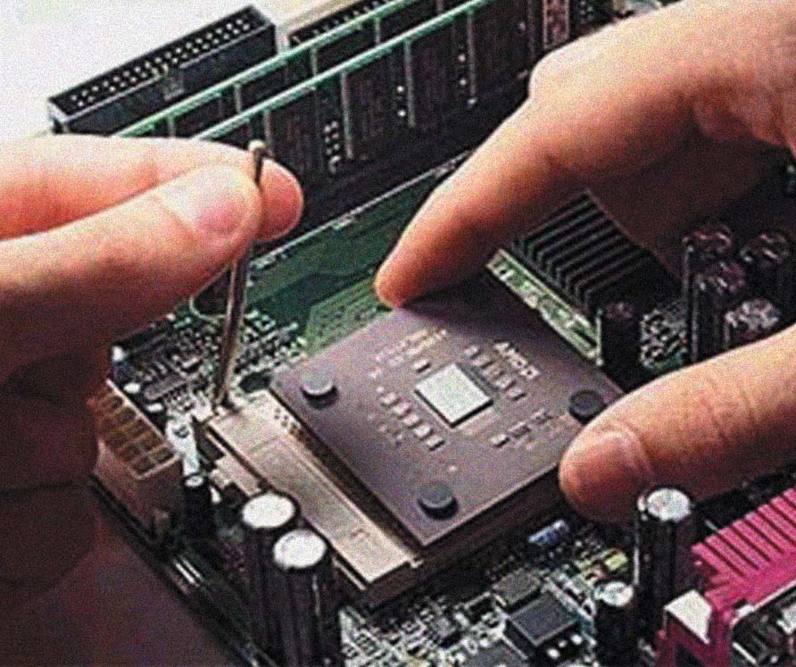
Upgrading the CPU
Expensive
Easy to install
Motherboard compatibility
Notes:
Replacement CPUs are expensive.
In addition, although it is reasonably easy to install a CPU, it can be difficult to determine which CPU to install. Not all CPUs are interchangeable, and the replacement CPU must be compatible with the motherboard.

Slide 31
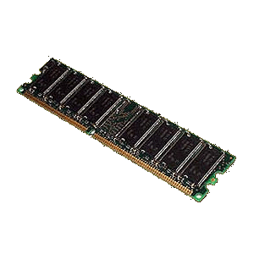
Evaluating RAM
Random access memory (RAM):
Temporary storage (memory)
Volatile
Memory modules:
SIMM
DIMM
RIMM
Types of RAM:
SRAM
DRAM
SDRAM
Notes:
Random access memory (RAM) is your computer’s temporary storage space. Although we refer to RAM as a form of storage, RAM is really the computer’s short-term memory. As such, it remembers everything that the computer needs to process the data into information, such as inputted data and software instructions, but only while the computer is on.
This means that RAM is an example of volatile storage. When the power is off, the data stored in RAM is cleared out. This is why, in addition to RAM, systems always include nonvolatile storage devices for permanent storage of instructions and data when the computer is powered off. Hard disks provide the greatest nonvolatile storage capacity in the computer system.
Memory modules (or memory cards), the small circuit boards that hold a series of RAM chips, fit into special slots on the motherboard. Most memory modules in today’s systems are called dual inline memory modules (DIMMs).
Several different types of RAM are available.
-Currently, DDR SDRAM is very common in the marketplace, although some high-performance systems offer the even faster DDR2 RAM.
RAM has a significant impact on the overall performance of your computer.

Slide 32
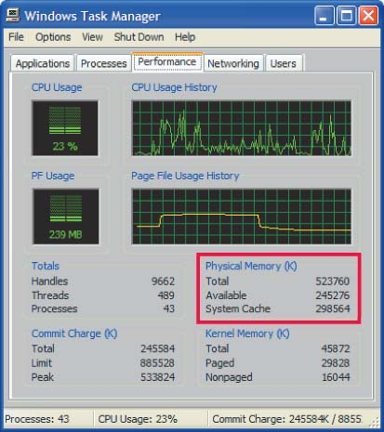
How Much Ram is Needed
RAM for System Software
RAM for Productivity Software
RAM for Entertainment
RAM for Graphics Programs
System Software | Windows XP | 128 MB
Productivity Software | MS Office Pro | 128 MB
Entertainment Software | Windows Media Player | 64 MB
Graphics | MS Picture It! | 128 MB
Notes:
To determine how much RAM is needed you must look at the memory requirements of each program and add them up.
Windows XP requires 128 Megabytes of RAM
Office Pro requires 128 Megabytes
Windows Media Player requires 64 megabytes of RAM
MS Picture It! calls for 128 MB of RAM
Together 460 megabytes are required

Slide 33
Adding RAM
Increase system performance
Things to consider:
Type of RAM module
Amount of RAM:
Maximum limit
Number of slots
Operating system
Applications running at the same time
Notes:
Adding RAM can have a big effect on system performance.
You need to make sure you add the correct type of RAM for your machine.
Each computer is designed with a specific number of slots on the memory board in which memory cards fit, and each slot may have a limit on the amount of RAM it can support.
In addition, the OS running on that machine may impose its own limit. To determine these limits, check your owner’s manual or the manufacturer’s Web site.

Slide 34
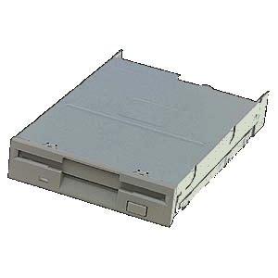
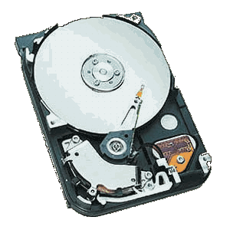
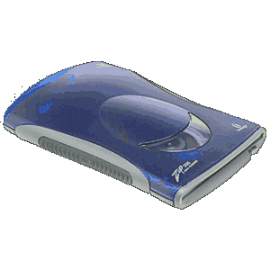
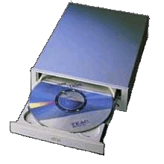
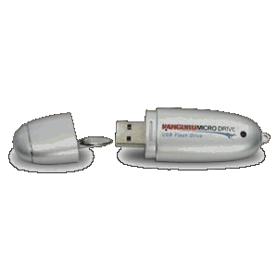
Evaluating Storage
Types of storage devices:
Hard drive
Floppy drive
Zip disk drive
CD/DVD
Flash memory
Nonvolatile storage
Notes:
So, RAM is a form of temporary storage—anything residing in RAM is not permanently saved. Therefore, it’s critical to have means to store data and software applications permanently.
Several storage options exist, including the hard disk drive, floppy disk drive, Zip disk drive, USB flash drives, and CD and DVD drives.
When you turn off your computer, the data stored to these devices is saved. These devices are therefore referred to as nonvolatile storage devices.

Slide 35
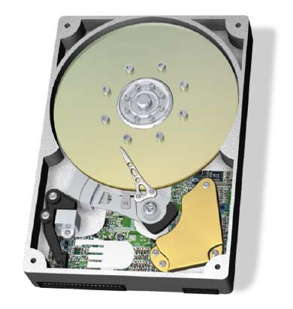
The Hard Disk Drive
Storage capacity up to 400 GB
Access time is measured in milliseconds
Data transfer rate is measured in megabits or megabytes per second
Spindle speed is measured in revolutions per minute (rpm)
Notes:
Of all the nonvolatile storage devices, the hard disk drive (or just hard drive) is used the most.
With storage capacities of up to 500 GB, hard disk drives have the largest storage capacity of any storage device.
The hard drive’s access time, or the time it takes a storage device to locate its stored data and make it available for processing, is also the fastest of all permanent storage devices. Hard drive access times are measured in milliseconds, or thousandths of seconds.
Another reason hard drives are popular is that they transfer data to other computer components (such as RAM) much faster than the other storage devices do. This speed of transfer is referred to as data transfer rate and is expressed in either megabits or megabytes per second.

Slide 36
How a Hard Disk Works
Composed of several coated platters stacked on a spindle
Data saved to the disk: pattern of magnetized spots – Spots = 1 – Spaces = 0
Between platters are read/write heads that read and write magnetized data
Spots are translated into data
Read/write head
Platters
Access arms
Notes:
A hard disk drive is composed of several coated platters stacked onto a spindle.
When data is saved to a hard disk, a pattern of magnetized spots is created on the iron oxide coating each platter.
Each of these spots represents a 1, whereas the spaces not “spotted” represent a 0.
These 0s and 1s are bits (or binary digits) and are the smallest pieces of data that computers can understand.
Sitting between each platter are special “arms” that contain read/write heads. The read/write heads move from the outer edge of the spinning platters to the center to read and write the magnetic data to and from the hard disk.
When data stored on the hard disk is retrieved (or read), your computer translates these patterns of magnetized spots into the data you have saved.

Slide 37
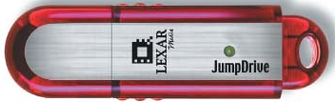
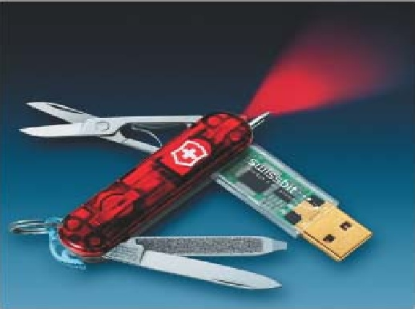
Portable Storage
Gives us the ability to move data from one computer to another
Types of portable storage devices:
Floppy disk:
Capacity 1.44 MB
Zip disk:
Capacity 100 MB to 750 MB
CD-R, CD-RW, DVD-R, DVD-RW:
Capacity 700 MB to 9.4 GB
Flash drive:
Capacity 32 MB to 1 GB
Notes:
To get data from one computer to another (assuming the computers aren’t networked), you’ll need a portable storage device.
The 3.5-inch floppy disk, with a storage capacity of 1.44 MB, holds the least amount of data. However, computer makers in the past year or so have stopped shipping floppy drives as standard equipment because floppy disks are too small to hold even one file that has been bulked up with multimedia.
Zip disks, with storage capacities ranging from 100 MB to 750 MB, and CD-R, CD-RW, DVD-R, and DVD-RW discs, with storage capacities ranging from 700 MB to 9.4 GB, have become increasingly popular to store large files.
Flash memory cards are another form of portable storage. These tiny removable memory cards are often used in digital cameras, MP3 players, and PDAs. Some flash cards can hold as much as 4 GB of data. As the technology becomes more popular, capacities will continue to increase.
This same technology is also packaged as flash drives (sometimes called thumb drives or jump drives). Small enough to fit on a key chain, a flash drive can hold up to 4 GB of data and can be plugged into any USB port
Note that these capacities continue to increase.

Slide 38
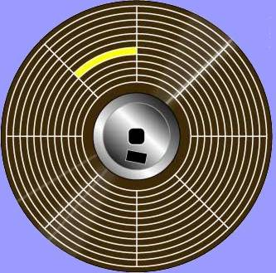
Magnetic Storage
Magnetic media:
Metal platters:
Hard disks
Plastic film:
Floppy disks
Zip disks
Tracks
Sectors
File Allocation Table
Track
Sector
Notes:
Like the hard drive, floppy and Zip disks are magnetic media.
Inside the plastic cases of both floppy and Zip disks you’ll find a round piece of plastic film. This film is covered with a magnetized coating of iron oxide. As is the case with hard drives, when data is saved to the disk, a pattern of magnetized spots is created on the iron oxide coating within established tracks and sectors.
Each of these spots represents either a 0 or a 1, or a bit. When data stored on the disk is retrieved (read), your computer translates these patterns of magnetized spots into information.

Slide 39
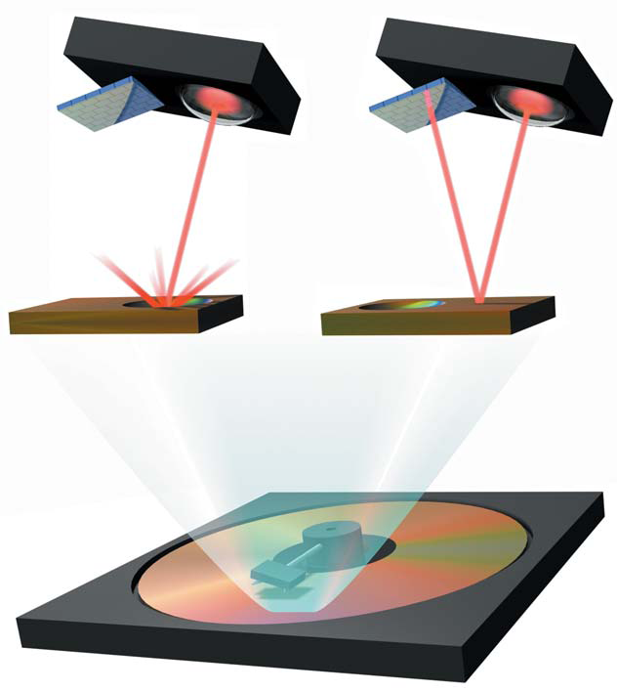
Optical Storage
Optical media:
CD ROM
CD-R
CD-RW
DVD ROM
DVD-R
DVD-RW
Laser
Pit
Land
Notes:
Like the hard drive and floppy and Zip disks, data is saved to CDs and DVDs within established tracks and sectors.
However, unlike floppy and Zip disks, which store their data on a piece of magnetized film, CDs and DVDs store data as tiny pits that are burned into a disk by a high-speed laser. These pits are extremely small, less than 1 micron in diameter, so that nearly 1,500 pits fit across the top of a pinhead.
Data is read off the CD by a laser beam, with the pits and nonpits translating into the 1s and 0s of the binary code computers understand.
Because CDs and DVDs use a laser to read and write data, they are referred to as optical media.
CD-ROMs are pre-recorded and cannot be written to. CD-Rs are blank and can be written to or burned once with a CD rewritable drive. CD-RWs start blank but can be rewritten or re-burned several times. The same pattern holds true for DVDs but at much higher capacities.

Slide 40
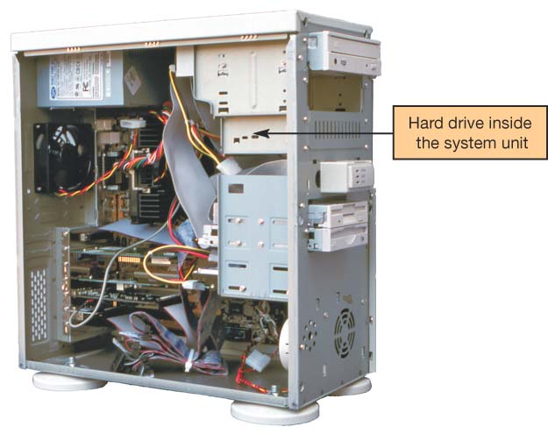
Upgrading Storage
Hard drive options:
Replace current drive with a larger capacity drive
Install an additional hard drive
Other options:
Zip drive
Replace CD ROM with CD-R/RW or DVD-R/RW
Flash card reader
Flash memory drive
Notes:
There are several ways in which you can increase your storage capacity or add extra drives to your computer.
If your hard drive is running out of space, you can replace the one installed in your system unit with a bigger one or you can install an additional hard drive in your current system if you have an extra drive bay. You might also chose to use an external hard drive you can plug into a USB or FireWire port.
If your computer didn’t come with an internal Zip, CD-RW, or DVD-RW drive, and if you have an open drive bay, you can install a drive there. If you don’t have open bays in your system, you can add external Zip and CD/DVD drives that you attach to your computer through an open port.
Although most desktop computers don’t include internal flash memory card readers, you can purchase external memory card readers that connect to your system through an open USB port.
You can also use flash drives, which plug directly into a USB port.

Slide 41

Evaluating Video
Two components:
Video card (adapter)
Monitor
Notes:
How video is displayed depends on two components: your video card and your monitor.
It’s important that your system have the correct monitor and video card to meet your needs.
If you use your computer system to display files that have complex graphics, such as videos on DVD or from your camcorder, or even play graphics-rich games with a lot of fast action, you may want to consider upgrading your video subsystem.

Slide 42
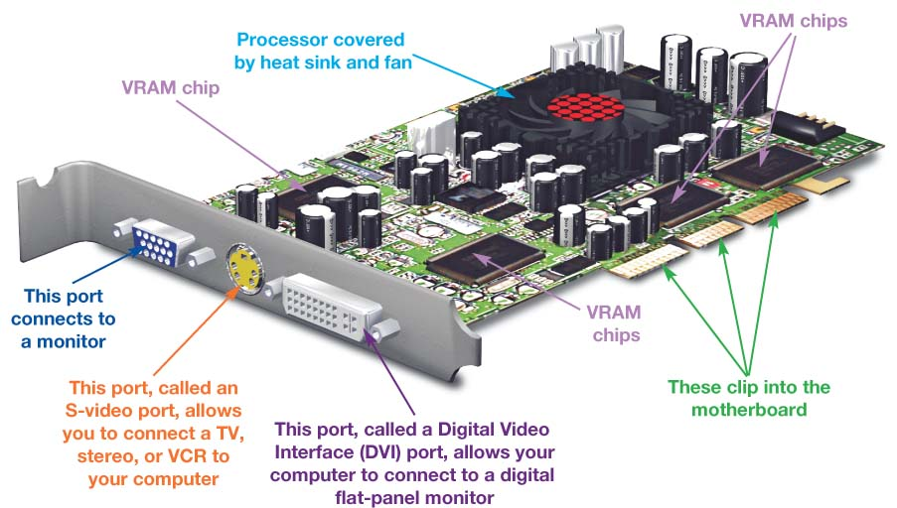
Video Cards
Process binary data into images
Contain memory known as video RAM (VRAM)
Control the number of colors a monitor can display (bit depth)
Standard VGA
4 bits
16 colors
True color (SVGA)
24 bits
16 million colors
Notes:
A video card (or video adapter) is an expansion card that is installed inside your system unit to translate binary data into the images you view on your monitor. Today, almost all computers ship with a video card installed.
Modern video cards include ports allowing you to connect to different video equipment as well as their own RAM, called video RAM (VRAM).
Video cards also come with their own processors. Calls to the CPU for graphics processing are redirected to the processor on the video card, significantly speeding up graphics processing.
The video card also controls the number of colors your monitor can display. The number of bits the video card uses to represent each pixel on the monitor (referred to as bit depth) determines the color quality of the image displayed. The more bits, the better the color detail of the image.
A 4-bit video card displays 16 colors, the minimum number of colors your system works with (referred to as Standard VGA). Most video cards today are 24-bit cards, displaying over 16 million colors. This mode is called true color mode.

Slide 43
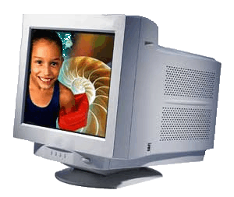
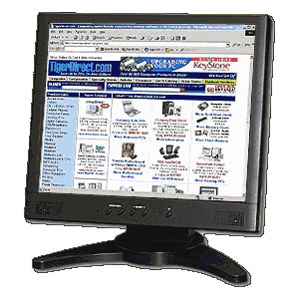
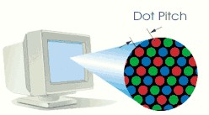
Monitors
Things to consider:
Types:
CRT or LCD
Size:
15, 17, 19, or 21 inch
Resolution:
Increasing resolution allows more to be displayed
Dot pitch:
.31mm or less
Refresh rate:
75 Hz or higher
Notes:
As you learned in Chapter 2, there are two types of monitors: CRT and LCD. If you currently have a CRT monitor and believe the advantages of the LCD are worth the extra money, you may want to upgrade.
Another factor you need to consider in evaluating your monitor is its size. The most common monitor sizes are 15, 17, 19, and 21 inches. Note that monitor size listed for CRT monitors is the diagonal measurement of the tube before it’s placed in the screen case. The actual viewing size is less. LCD monitors are also measured diagonally, but the measurement is equal to the viewing size.
Most monitors can display different resolutions. Changing the screen resolution can make a difference in what is displayed.

Slide 44
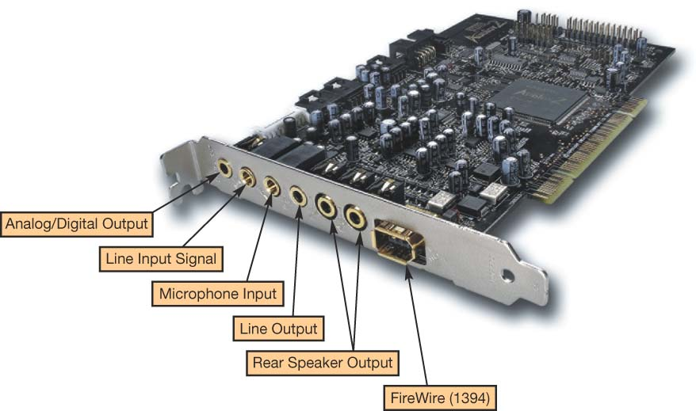
Evaluating Audio
Sound card:
Process digital data into sounds
3D sound cards
Surround sound
Dolby Digital 5.1
Notes:
The audio subsystem consists of speakers and a sound card..
Sound cards attach to the motherboard and enable your computer to produce sounds.
Most computers ship with a basic sound card, most of which are 3D sound cards. 3D sound is better at convincing the human ear that sound is omnidirectional, meaning you can’t tell from which direction the sound is coming. This tends to produce a fuller, richer sound than stereo sound.
To set up surround sound on your computer, you need two things: a set of surround-sound speakers and a sound card that is Dolby 7.1 compatible.
Dolby 6.1 and 5.1 are also still on the market and have six speakers plus subwoofer or five speakers plus subwoofer, respectively.

Slide 45
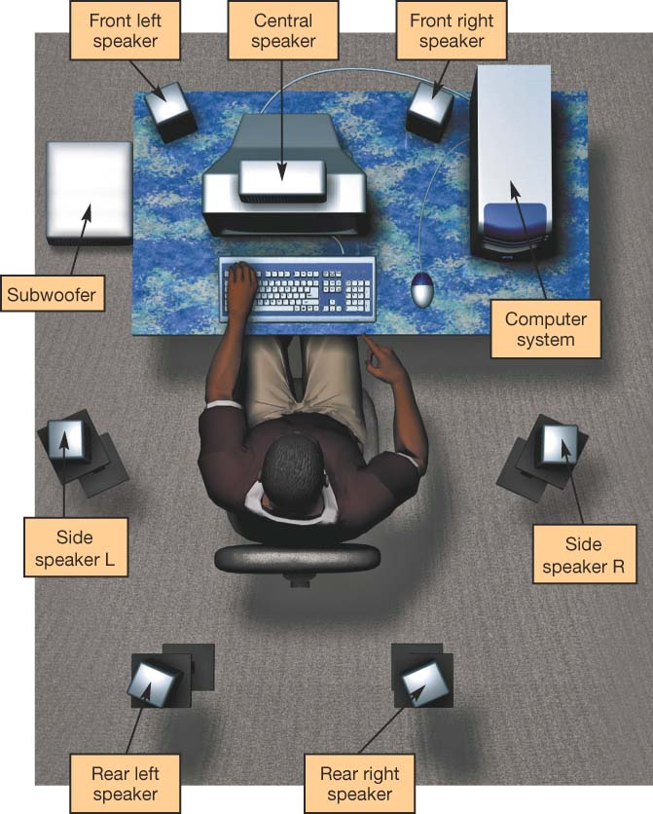
Evaluating Audio
Speakers:
Amplified
Not amplified
Sub-woofer
Surround sound
Notes:
Two types of speakers ship with most personal computers: amplified speakers (which use external power) or unamplified speakers (which use internal power).
Amplified speakers generally produce better quality sound. However, they usually do not adequately reproduce the bass sounds that make gaming and musical scores sound richer and fuller. For better bass sounds, buy a speaker system that includes a subwoofer To set up surround sound on your computer, you need two things: a set of surround-sound speakers and a sound card that is Dolby 7.1 compatible.
The current surround-sound standard is Dolby Digital 7.1. The 7.1 format takes digital sound from a medium and reproduces it in eight channels. Seven channels cover the listening field with placement to the left front, right front, and center of the audio stage, as well as the left rear and right rear, and then two extra side speakers are added. The eighth channel holds very low-frequency sound data and is sent to a subwoofer.
Dolby 6.1 and 5.1 are also still on the market and have six speakers plus subwoofer or five speakers plus subwoofer, respectively

Slide 46
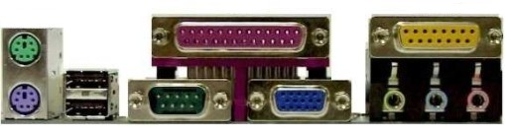
Evaluating Ports
Ports are used to connect peripheral devices to the computer
Things to consider:
Devices you want to use
Ports needed for the devices
Notes:
A port is an interface through which peripheral devices are connected to your computer.
Each type of port operates at a certain speed, measured in either kilobits per second (Kbps) or megabits per second (Mbps)
To evaluate your system’s port connectivity, check the devices you’d like to be able to connect to your computer and look for what type of port they require. Does your system have the ports necessary to connect to all of these devices?

Slide 47
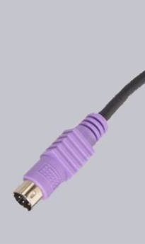
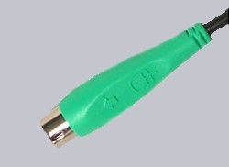
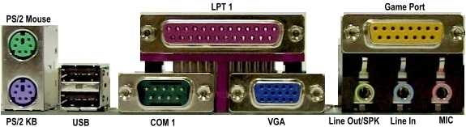
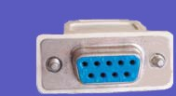
Types of Ports
Serial Port
Transfers data one bit at a time; 56Kbps
PS/2 Connectors
PS/2 Port
COM 1 Port
Serial Connector
Notes:
The most common types of ports include serial, parallel, universal serial bus (USB), FireWire, and Ethernet.
The serial port allows the transfer of data, one bit at a time, over a single wire at speeds of up to 56 Kbps. Typical devices that still connect to serial ports include external modems and PDA cradles. Traditional serial ports are slowly being phased out by faster ports.

Slide 48
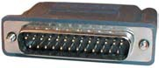
Types of Ports
Parallel
Transfers eight bits of data simultaneously; 12Mbps
LPT 1 Port
Printer Cable Connector
Notes:
A parallel port sends data between devices in groups of bits at data transfer rates of 12 Mbps. Parallel ports have traditionally been used to connect printers and scanners to computers but are becoming less popular in favor of faster ports.

Slide 49
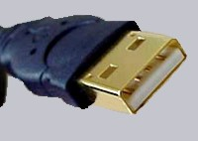
Types of Ports
Universal serial bus
Transfer speed up to 480Mbps; Hot swapping
USB Port
USB Connector
Notes:
The universal serial bus (USB) port is fast becoming the most common port on computers today. The original USB (version 1.1) port could transfer data at only 12 Mbps. However, in 2002, USB version 2 was released, increasing throughput to 480 Mbps. Printers, scanners, digital cameras, keyboards, mice and hard disk drives can all be connected to the computer using USB ports.

Slide 50
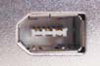
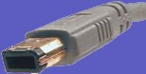
Types of Ports
FireWire
Transfer rate of 400 Mbps; Digital cameras
FireWire Port
FireWire Connector
Notes:
Until USB 2.0, the FireWire port was the fastest port available, with a transfer rate of 400 Mbps. Today, it is used to connect digital video devices or hard drives to the computer.

Slide 51
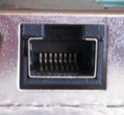
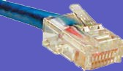
Types of Ports
Ethernet
Transfer rate of 100 Mbps; connects computers to networks
Ethernet Port
Ethernet jack
Notes:
The Ethernet port is used to connect your computer to a local network or cable modem. Ethernet originally offered a transfer rate of 10 Mbps. Fast Ethernet (called 100Base-T), with a transfer rate of 100 Mbps, is the standard used in most PCs today.

Slide 52
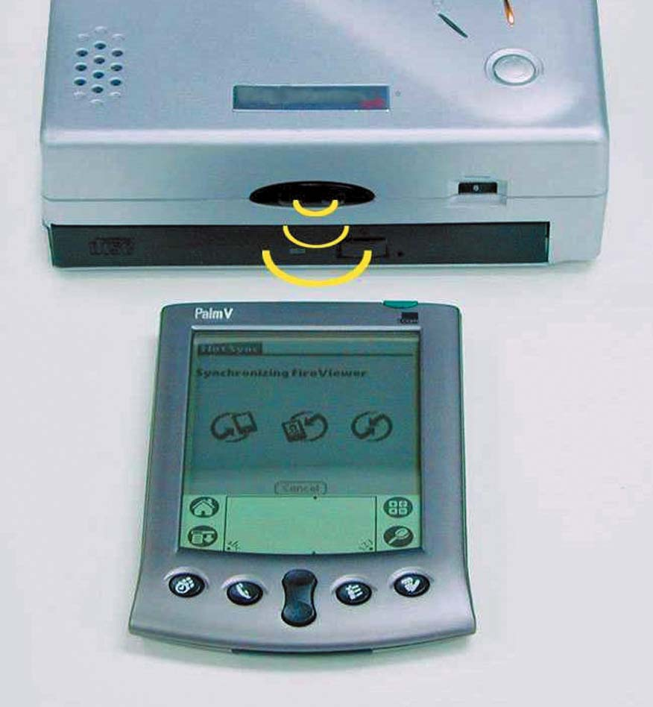
Types of Ports
IrDA
Transfer rate of 4 Mbps; Uses infrared light waves
IrDA
Notes:
IrDA ports enable you to transmit data between two devices by using infrared light waves. IrDA ports have a maximum throughput of 4 Mbps and require that a line of sight be maintained between the two ports. Many printers, laptops, and PDAs include IrDA ports

Slide 53
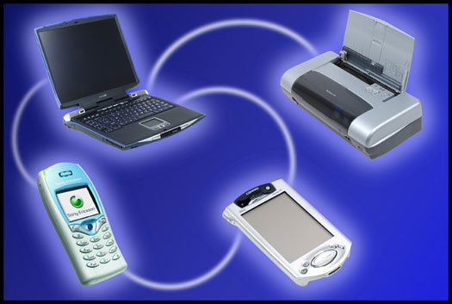
Types of Ports
Bluetooth
Transfer rate of 1 Mbps; radio waves send data over short distances
Bluetooth
Notes:
Bluetooth uses radio waves to send data over short distances. The maximum transfer rate of the original Bluetooth 1.0 is 1 Mbps. The newer standard Bluetooth 2.0 has a transfer rate of 3 Mbps. Many laptops and PDAs include a Bluetooth chip that allows them to transfer data wirelessly to any other device with a Bluetooth chip. The advantage of Bluetooth devices is that a clear line of sight isn’t needed between the two devices.

Slide 54
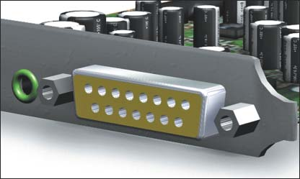
Types of Ports
MIDI Port
Musical Instrument Digital Interface
31.5 Kbps transfer rate
Notes:
A MIDI port allows you to connect electronic musical instruments (such as synthesizers) to your computer. Data is transferred between the computer and the MIDI device at a rate of 31.5 Kbps. In addition to synthesizers, MIDI ports also work with electronic drum machines and other electronically adapted instruments.

Slide 55
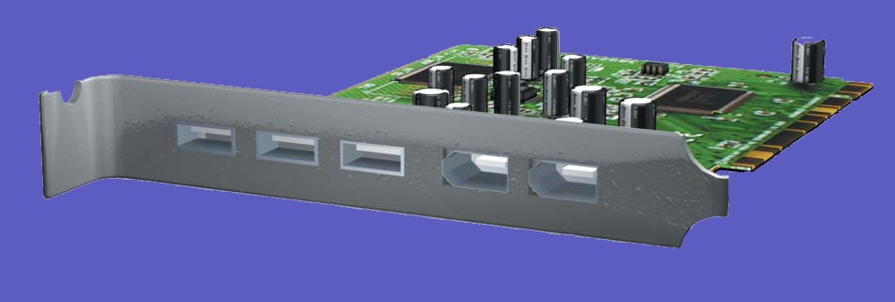
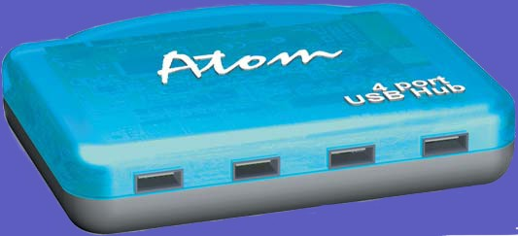
Adding Ports
Expansion cards:
New port standards
Expansion hubs:
Enables several devices to be connected to a port
Notes:
Special expansion cards are one way to add new ports to an older computer or to expand the number of ports on your computer. Like other expansion cards, these cards clip into an open expansion slot on the motherboard.
If there are no open slots on the motherboard and you still need extra ports, you can add an expansion hub, a device that connects to one port, such as a USB port, to provide four or eight new ports, similar to a multiplug extension cord you use with electrical appliances.

Slide 56

Evaluating System Reliability
Performance:
Slow
Freezes
Crashes
Upkeep and maintenance:
System tools
Control panel
Update software and hardware drivers
The last resort
Notes:
Before you buy a new system because you think yours may be unreliable, make sure the problem is not one you can fix. Proper upkeep and maintenance may also postpone an expensive system upgrade or replacement.

Slide 57
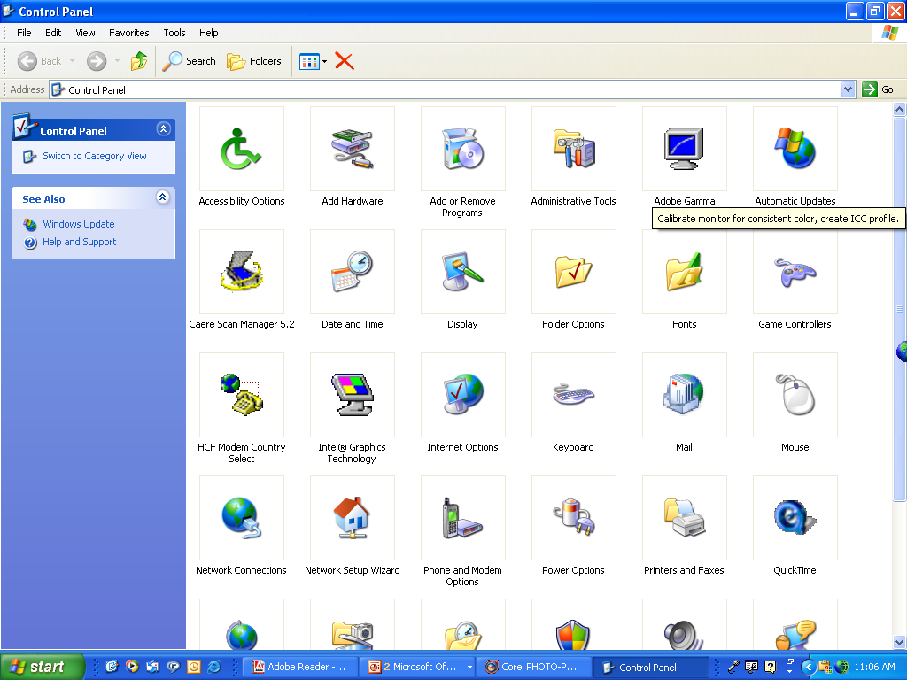
Upkeep and Maintenance
System tools:
Disk defragmenter
Disk cleanup
Unnecessary files
Control panel:
Add/remove programs
Display
System
Device manager
Notes:
There are several procedures you can follow to ensure your system performs reliably:
1. Clean out your Startup folder. Some programs install themselves into your Startup folder and are automatically run each time the computer reboots. This unnecessary load causes extra stress on RAM. Make sure you delete only programs you know for sure are unnecessary.
2. Clear out unnecessary files. Temporary Internet files can accumulate quickly on your hard drive. Running the Disk Cleanup utility is a quick and easy way to ensure these files don’t take up hard drive space. Likewise, delete unnecessary files from your hard drive regularly.
3. Run an anti-spyware program as well as an anti-adware program. These often detect and remove different pests and should be used in addition to your regular anti-virus package.
4. Run the Disk Defragmenter utility on your hard drive. When your hard drive becomes fragmented, its storage capacity is negatively impacted. When you defrag your hard drive, files are reorganized, making the hard drive work more efficiently.

Slide 58
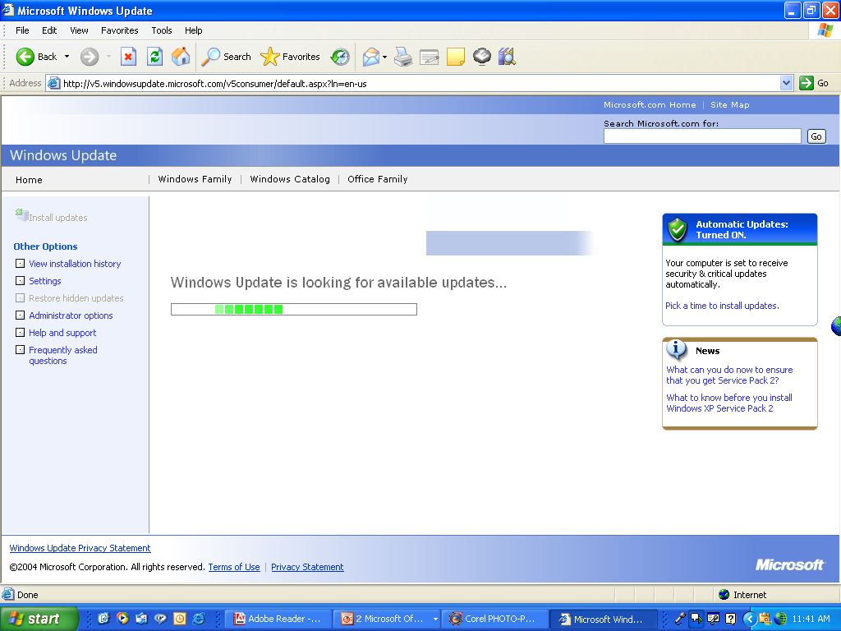
Update Software and Hardware Drivers
Software:
Automatic updates
Patches
Hardware:
Download updated drivers
Notes:
Having the latest version of software products makes your system much more reliable. You should upgrade or update your operating system, browser software, and application software as often as new patches (or fixes) are reported for resolving errors. Sometimes these errors are performance related; sometimes they’re tied to maintaining better security for your system.
You can configure Windows XP so that it automatically checks for, downloads, and installs any available updates for itself and for Internet Explorer. In addition, products such as McAfee’s Oil Change enable you to sort through numerous Web sites and quickly find the bug fixes for most application software

Slide 59
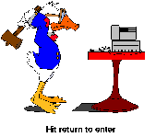
The Last Resort
If problems persist:
Reinstall the operating system
Upgrade the operating system to the latest version
Notes:
When all else fails, you have two options:
1. Reinstall the operating system. To do so, you’ll want to back up all of your data files before the installation and be prepared to reinstall your software after the installation. Make sure you have all of the original discs for the software installed on your system, along with the product keys, serial numbers, or other activation codes so that you can reinstall them.
2. Upgrade your operating system to the latest version. There are substantial increases in reliability with each major release of a new operating system. However, upgrading the operating system may require hardware upgrades. Be sure to examine the recommended (not required) specifications of the new operating system.

Slide 60
The Final Decision
How closely does your system come to meeting your needs?
How much would it cost to upgrade your system?
How much would it cost to purchase a new system?
Notes:
When a decision is required you have to ask yourself how you use your computer system. How might you use it if it were more capable? Can your existing system do what you want it to? If not, can you purchase the parts and install them to meet the capability? Then, if you add up the cost of the parts, figure in the value of headaches and labor required to install those parts and compare the total to the cost of a new machine that will do the same tasks and more, you arrive at a point where the decision should be easy.

Slide 61
NOW

